Slide 1
TITLE:- Meet Mate: AI Agent for Smarter Online Meetings
ABD TEAM MEMBERS
REG.NO:- 231FA04206
231FA04216
231FA04233
231FA04942

Slide 2
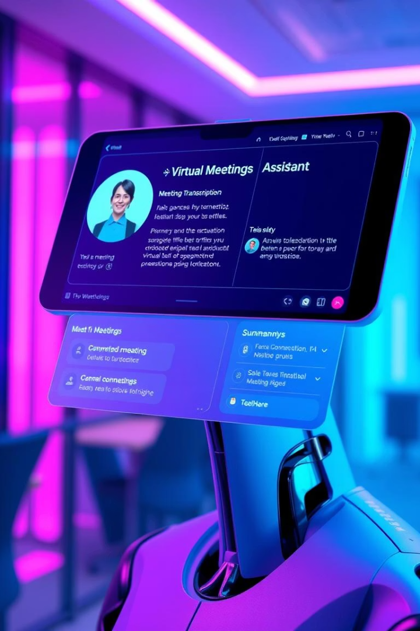
MeetMate: AI Agent for Smarter Online Meetings
MeetMate is an advanced AI-powered virtual meeting assistant designed to significantly enhance workplace productivity. By joining or listening to online meetings, MeetMate performs intelligent tasks such as automatic summarization, Q&A, real-time transcription, multilingual translation, and follow-up coordination. Ideal for remote teams and multilingual organizations, this tool saves time, fosters engagement, and improves action follow-through during and after meetings.

Slide 3

Real-Time Meeting Summary and Auto-Mail Feature
Real-Time Summarization
Automated Email Delivery
Uses speech recognition (e.g., Whisper) to transcribe discussions instantly and transformer models (BART, T5) to generate concise summaries with key highlights and action items.
Automatically sends meeting summaries and subject-wise bullet points to all participants via email, ensuring everyone stays informed of decisions and next steps.

Slide 4
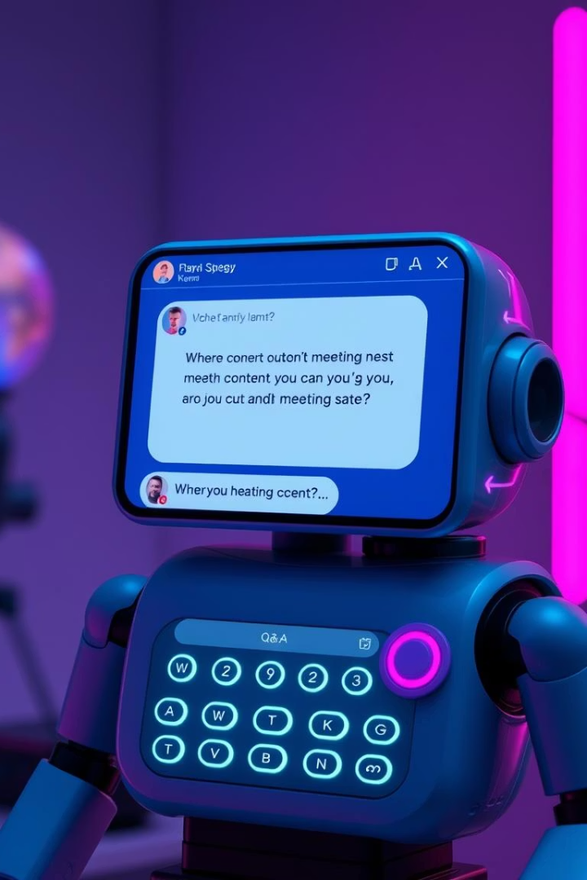
Contextual Question & Answering Module
Transformer-Powered Q&A
Enables participants to query meeting content contextually, such as decisions or specific comments, leveraging fine-tuned BERT models for accurate answers.
Intelligent Transcript Parsing
Automatically interprets meeting transcripts to provide precise, relevant responses to user inquiries during or after the meeting.

Slide 5
Multilingual Summary Translation and Audio Support
Summary Translation APIs
Text-to-Speech Audio Summaries
Utilizes Google Translate API and translation libraries to render meeting summaries in languages such as Tamil, Hindi, and French, breaking language barriers.
Generates accessible audio versions of summaries using gTTS, enabling participants to listen to key meeting insights on the go or aiding accessibility needs.

Slide 6




Advanced Topic Clustering and Sentiment Analysis
Keyword and Topic Clustering
Participant Sentiment Analysis
Implements KMeans clustering to group discussion topics and agenda items, enabling visualization of speaking patterns by participants and themes.
Applies predictive models to detect emotional tone shifts, reporting meeting mood and key sentiment transitions for deeper meeting insights.

Slide 7
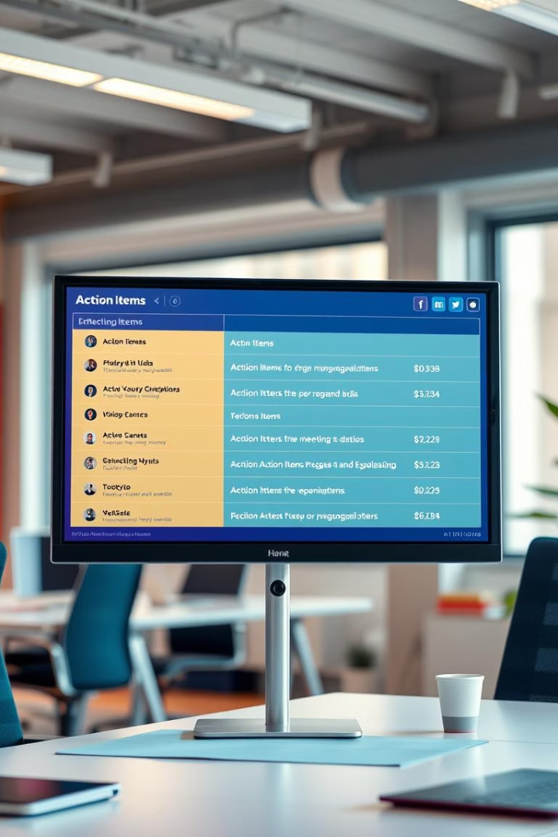


Automated Action Item Extraction
Identify To-Do Items
Natural language processing techniques extract actionable tasks from conversation, isolating commitments and deadlines.
Assign Responsibilities
Automatically assigns tasks to specific speakers based on context, ensuring clear accountability within the team.

Slide 8
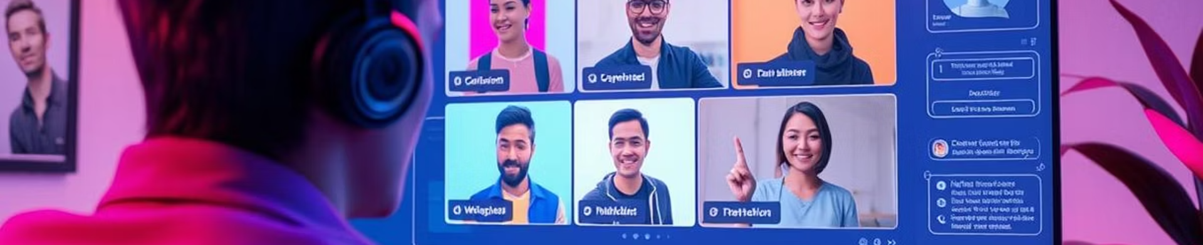
Voice-Controlled Interaction
Command Execution
Voice Queries
Processes voice commands to control AI assistant functions such as fetching information or initiating follow-ups seamlessly.
Enables hands-free querying of meeting content and summaries during or after meetings, improving user convenience and interaction speed.

Slide 9



Integration with Calendar and Email Systems
Automatic Scheduling
Email Sync
Generates follow-up meetings and sends calendar invites based on extracted actions and decisions to maintain workflow continuity.
Seamlessly sends updates and reminders via email, reinforcing communication and task tracking across teams.

Slide 10

MeetMate Impact and Roadmap for AI Virtual Meeting Assistants
MeetMate represents the future of workplace productivity through AI-enabled meeting intelligence. By automating note-taking, enabling multilingual accessibility, and facilitating collaboration with voice and calendar integrations, MeetMate saves time and fosters inclusivity. This innovation is invaluable for remote teams, classrooms, and global organizations striving for efficient communication.
Moving forward, enhancing AI’s contextual understanding, expanding multilingual capabilities, and refining voice interactions remain key development goals to further improve user experience and meeting effectiveness.

Slide 11


